Slide 1
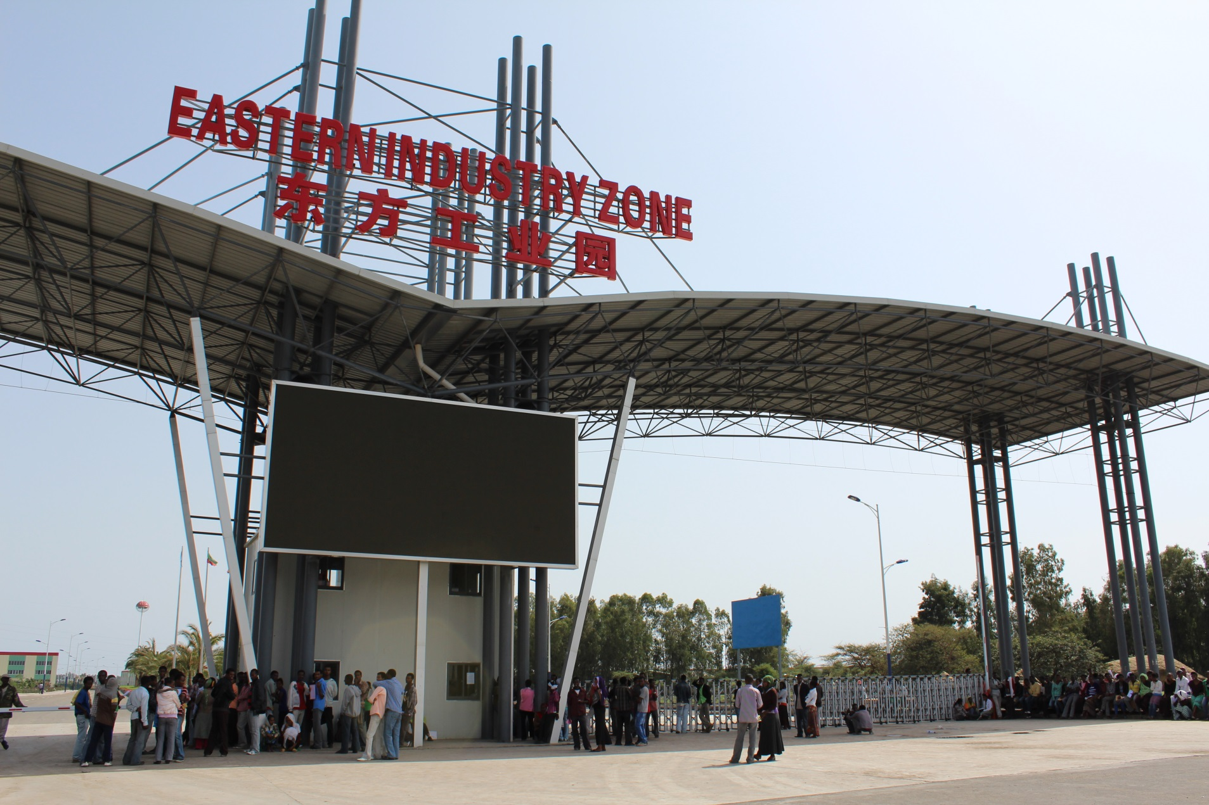
How Chinese SEZs support economic transformation in Africa?
TANG Xiaoyang Tsinghua University
2015.06.15

Slide 2
Sections
Introduction
Motives of Chinese firms to invest in SEZs in Africa
Effects of SEZs on economic transformation in Africa
Suggestions to maximize impacts towards economic transformation

Slide 3
“Going Out” Strategy
Originally from the oversea expansion of Chinese enterprises
In 1999, Haier established an industrial park covering 46 hectares in South Carolina in America
In 2000, Fujian Overseas Chinese Industrial Group established the processing trade district in Cuba
In 2001, Haier established an industrial park in the form of joint ventures with Pakistan corporations
In 2002, Henan GuoJi Group invested in the renovation of the industrial park in Sierra Leone
In 2003, China Nonferrous Metal Mining Group take advantages of the surface land above Zambian Chambishi Copper Mines to develop smelting industry

Slide 4
Ministry of Commerce Tenders
Zone Name | Country | Location | Tender Year | Lead Chinese Developer | Home Province or Municp. | Zone sector focus
Asiadata | Russia | Ussuriysk Eastern Siberia | 2006 | Kangnai Group | Zhejiang | Industrial estate
Baltic | Russia | St. Petersburg | 2006 | Shanghai Industrial Investment Holding | Shanghai | Real estate
Chambishi | Zambia | Chambishi | 2006 | Nonferrous Metals Mining Group | national | Mining
Eastern | Ethiopia | Addis Ababa | 2007 | Jiangsu Qiyaan Investment Group | Jiangsu | Steel product, Construction materials
Geely | Mexico | Aguascalientes | 2007 | Geely Automobiles | Zhejiang | Automobile
Guangxi | Indonesia | Central Jawa Wonogiri | 2007 | Guangxi Farm (Nongken) Group | Guangxi AR | Cassava processing
Haier-Ruba | Pakistan | Punjab, Lahore | 2006 | Haier | Shandong | Home appliance
Jiangling | Algeria |  | 2007 | Jianling Automobile | Jiangxi | Automobile
Jinfei | Mauritius | Terre Rouge | 2006 | Shanxi Tianli Enterprise Group | Shanxi | Industrial & Real estate
Lacua? | Venezuela | Paraguana | 2007 | Inspur Group | Shandong | Hi-tech, IT
Lekki | Nigeria | Lagos State | 2007 | China Civil Engineering and Construction Corp. (CCECC) | national | Industrial estate
Longjiang | Vietnam | Tien Giang | 2007 | Qianjiang Investment Mngt. Ltd. | Zhejiang | Industrial estate
Muan | S. Korea | Muan | 2007 | Dongtai Hua'an Internt'l Investment | Chongqing | industrial & Real estate
Ogun | Nigeria | Ogun State | 2006 | Guangdong Xindong | Guangdong | Industrial estate
Rayong | Thailand | Thonburi | 2006 | Holley Group | Zhejiang | Industrial & Real estate
Shenzhen | Vietnam | Yen Hung | 2007 | Shenzhen International Cooperation Group | Shenzhen | Electronics & textile
Taihu | Cambodia | Sihanouk Harbour | 2006 | Hongdou Group | Jiangsu | Industrial & Real estate
Teda | Egypt | Suez | 2007 | Tianjin TEDA | Tianjin | Industrial estate
Tomsk | Russia | Central Siberia | 2007 | Yantai Northwest Forestry Co. | Shandong | Wood processing

Slide 5
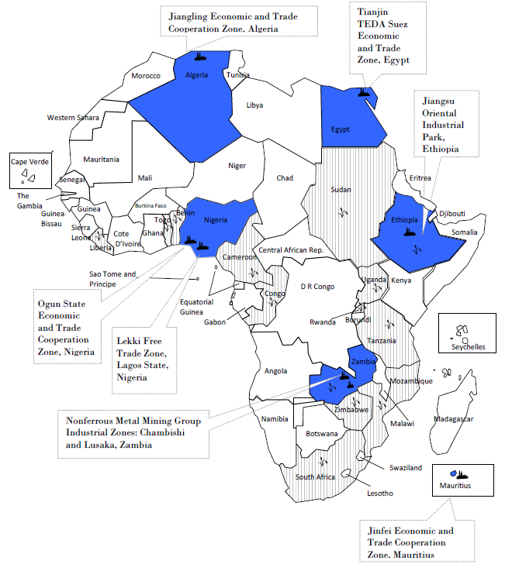
Chinese SEZs in Africa
Slower than plan
Steady progress
Growing enthusiasm

Slide 6
Motives of Chinese SEZs
Rapid Growth of Chinese Investments in Africa, particularly in manufacturing
China's Outward FDI to Africa 2004-2012, in millions USD.
Source: Chinese Commercial Statistics Yearbook

Slide 7
Motives of Chinese SEZs
Distribution of Chinese Enterprises By Sector
Industry (out of 3094 registrations) | % of MOFCOM-registered firms
Wholesale and retail trade | 70.9%
Manufacturing | 47.9%
Mining | 46.9%
Leasing and business services | 29.9%
Scientific, technical services and geological prospecting | 29.2%
Construction industry | 23.4%
Residential services and other services | 8.3%
Agriculture, forestry, animal husbandry and fishery | 7.3%
Real Estate | 4.3%
Transportation, storage and postal services | 3.7%
Hospitality industry | 1.8%
* A firm can be involved in more than one industry. Source: MOFCOM

Slide 8
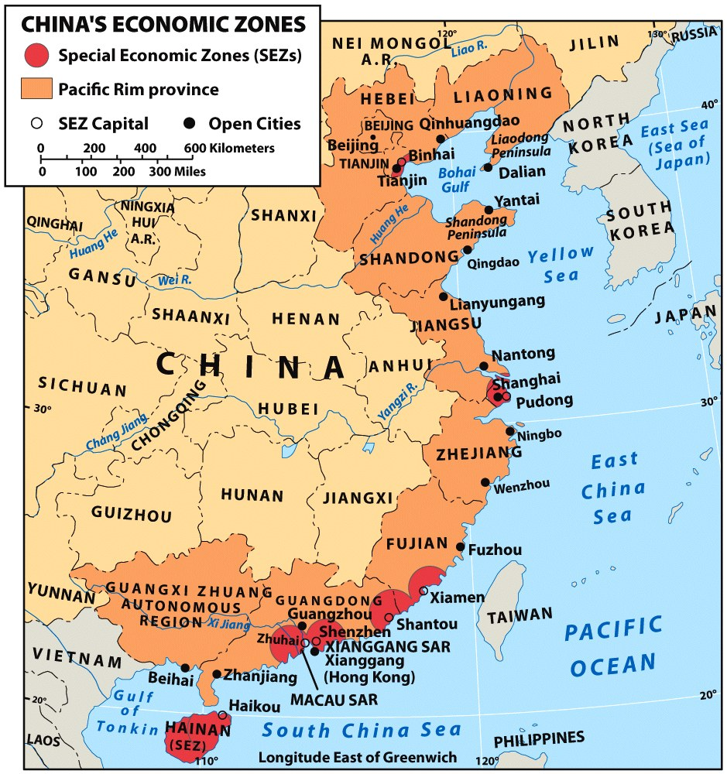
The Success of China’s SEZs
Motives of Chinese SEZs
In 1979, Shenzhen, Zhuhai, Shantou, Xiamen
In 1988, Hainan Province
In 1990, Pudong New District of Shanghai
1984-1988,14 national economic and technological development zones were established in coastal cities like Tianjin, Shanghai, Dalian, Guangzhou

Slide 9
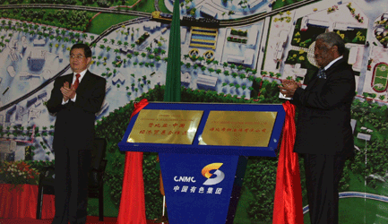
Political Incentives
Motives of Chinese SEZs
Financial support: subsidy, loan, equity investment
Transfer Chinese development model overseas
Cooperation zones included into the “one belt, one road” strategy

Slide 10
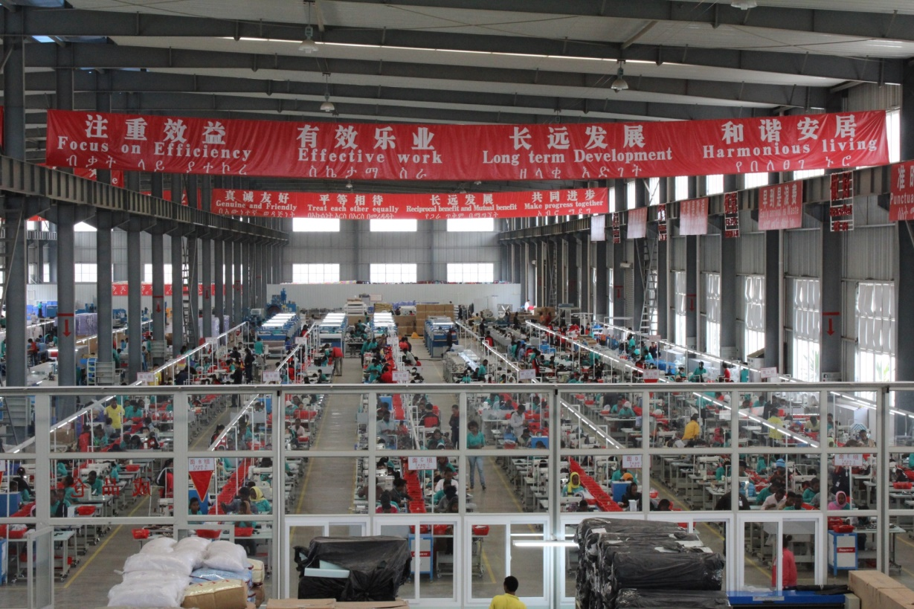
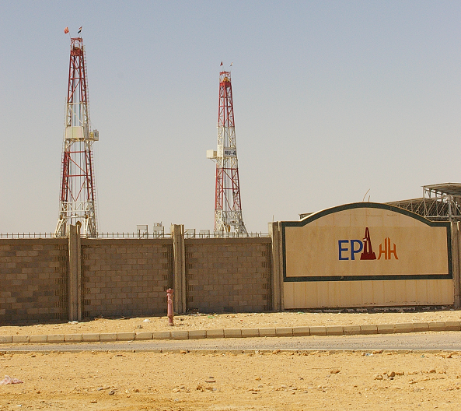
Manufacturing Powerhouse
Effects on Economic Transformation
Major industries: textile, shoe-making, construction materials, furniture, mineral processing, machinery
Create appro. 20,000 jobs for Africans
facilitate “flying geese” relocation

Slide 11
Zone Investment, circa July 2013
Effects on Economic Transformation
Source: author’s interviews and collection
 | Constr. Start Date | Phase I size (ha) | Est. constr. invest- ment ($US mil) | Actual constr. Invest- ment ($US mil) |  | No. of Tenant Com- panies (signed) | No. of Tenant s (in oper- ation) | Tenant commit- ments to invest ($US mil) | Tenant Company actual invest- ment ($US mil) | Tenants: Approx. # of Chinese workers | Approx. # of African Workers
Egypt TEDA | 2000 | 134 | 200 - 280 |  | 49.4 | 49 | 26 | 524 | 28 | 96 | 675
Zambia Chambishi | 2004 | 1158 | 200 |  | 150 | 21 | 19 | 1000 | 322 | 934 | 5724
Nigeria Lekki | 2007 | 109 | 392 |  | 82.5 | 26 | 6 | 700 | 76 | n/a | n/a
Mauritius Jinfei | 2009 | 70 | 220 |  | 15 | n/a | 0 | n/a | n/a | n/a | n/a
Nigeria Ogun | 2009 | 250 | 220 |  | 23.7 | 34 | 7 | 150 | 58.28 | 177 | 1619
Ethiopia Eastern | 2010 | 200 | 101 |  | 22 | 12 | 6 | 129.5 | n/a | 300 | 1600

Slide 12
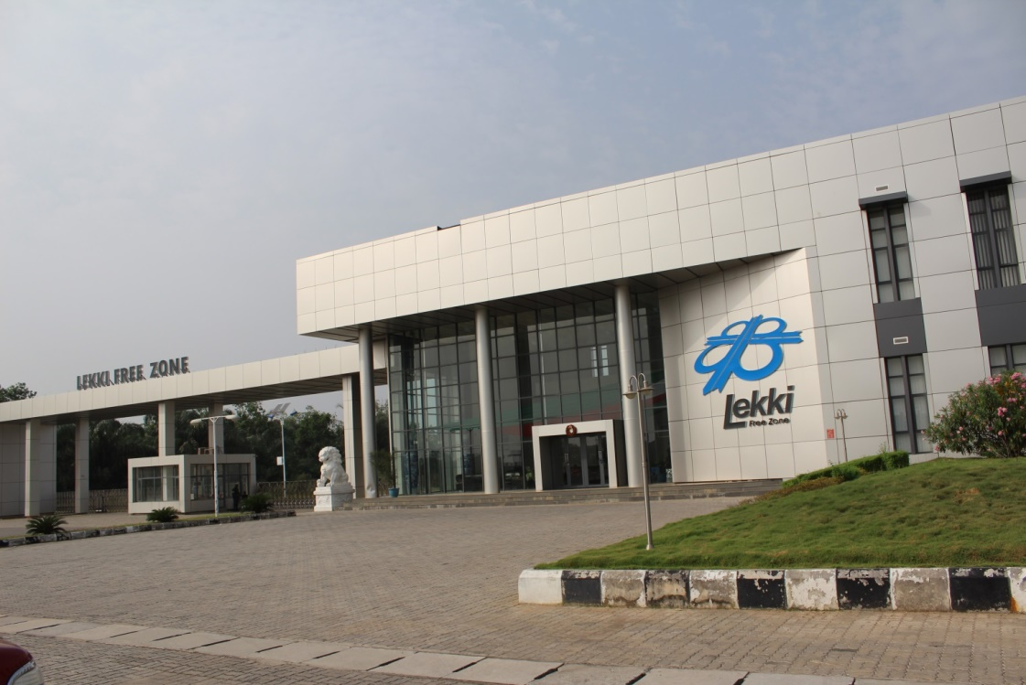
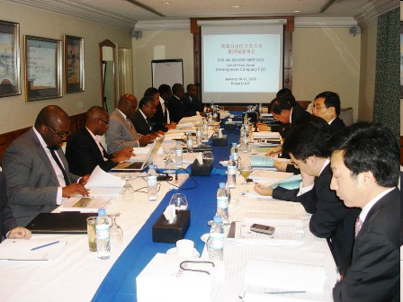
Streamlining Administration/Policy Improvement
Effects on Economic Transformation
Speed up customs procedures
Improve infrastructure management
Launch new SEZ programs
Platform for interaction and experience sharing

Slide 13
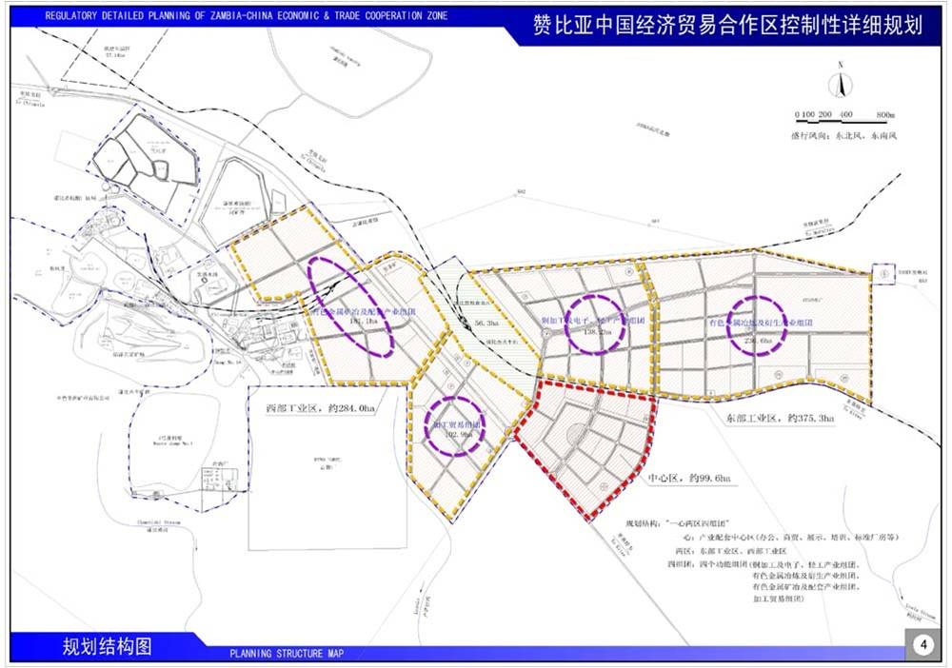
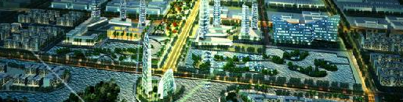
Contribute to urbanization in the long run
Effects on Economic Transformation
Ultimate source for profitability
Synergic development of industry, living and commerce
Based on China’s own experience

Slide 14
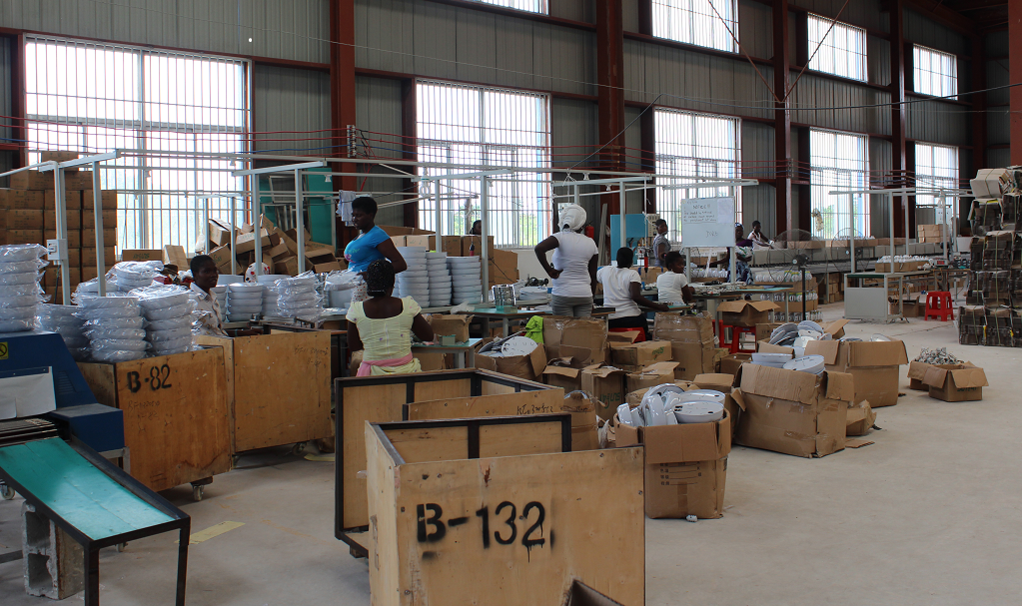
Strengthen local linkage of production
Suggestions to maximize impacts
Connect foreign investors with local suppliers
Bring in upstream and downstream investors to form clusters
Avoid “enclaves”

Slide 15
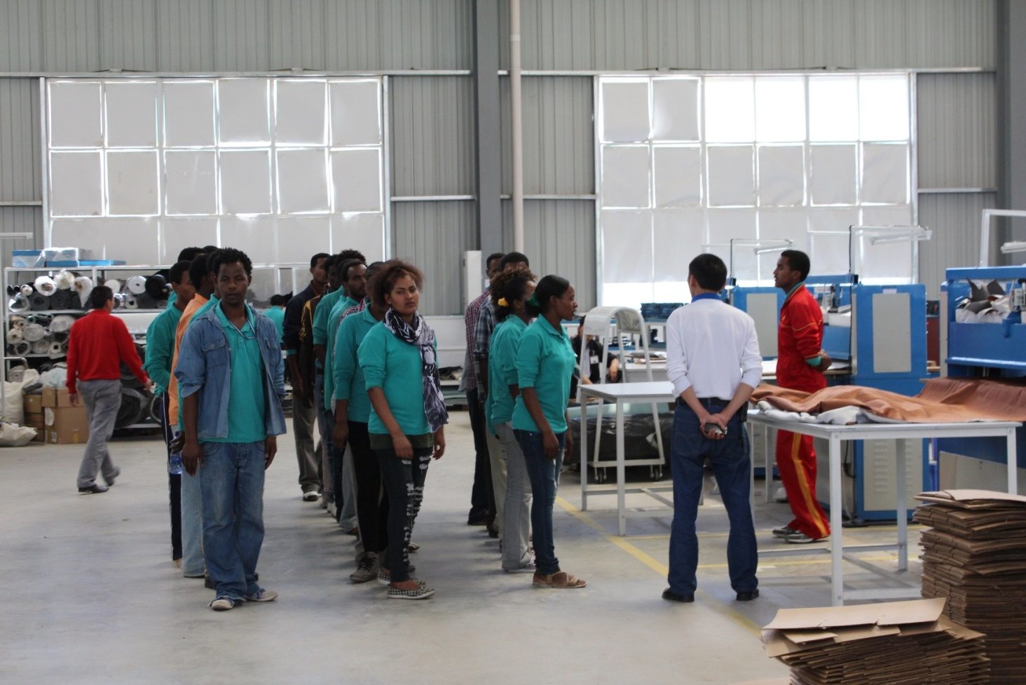
Encourage skill transfer
Suggestions to maximize impacts
Training of zone managers
Training of workers
“Spillover” effect

Slide 16
Increase local ownership
Suggestions to maximize impacts
Successful SEZ and broader development are interdependent
Increase Africa participation in decision making and senior management

Slide 17
Meanings and Functions of Special Economic Zones
Definition：Designated areas in countries which managed by a specialized agency and possess special economic regulations that are conducive to proposed enterprises. ——The World Bank
The first SEZ in the modern sense was established in Ireland in 1959
Types: Including export processing zones, free trade zones, industrial estates and so on
Although African countries began to set up special economic zones in the 1970s, the overall output is still very limited
In 2007, the value of total exports is $8.6 billion in Sub-Saharan special zones where they employed one million and forty thousand people, accounting for 0.2% of the total employment.
The value of total exports is $851 billion in the Asia-Pacific region where they created 61 million jobs, accounting for 2.3% of the total employment.

